Slide 1
Twitter Search Engine
(Group-3) Topic 5
Li-Jung Chen
Bo Wang
Shin-Jung Shieh

Slide 2
Why needed?
Predicting stock market movements is a well-known problem of interest.
Now-a-days social media is perfectly representing the public sentiment and opinion about current events.
Especially, twitter has attracted a lot of attention from researchers for studying the public sentiments.

Slide 3
Limitation (Twitter Standard API)
If api.user_timeline method is used to collect tweets from a particular twitter account , only the most recent 3240 tweets of a specific user can be collected.
If api.search method is used to search the key words from all accounts , only the past 10 days data will be displayed.
If streaming api is used , only the up-to-date data can be displayed ，the historical data can not be fetched.

Slide 4
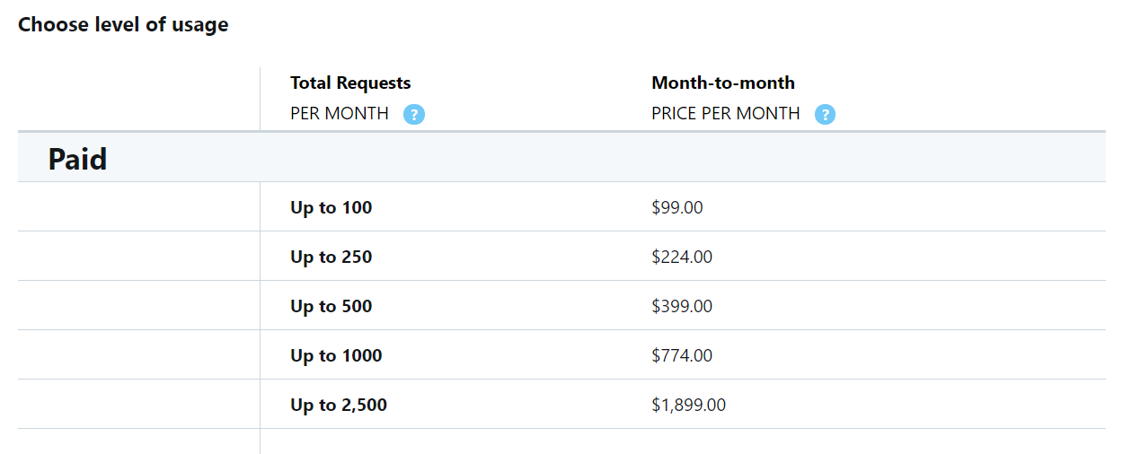
Solutions
a. Register for Twitter Premium API
b. Implement Twitter Search Engine
500 tweets per request

Slide 5
Implement Twitter Search Engine
Step 1: Get all tweets ids
Step 2: Use twitter api to collect all tweets data
Step 3: Data filtering
Run multi_scrap_queue.py to get all tweets ids of user accounts in csv files
Run preprocessing.py to get only topic related tweets data.
Run get_metadata.py to gather all tweets data (user_name , create_date , tweet_text)

Slide 6
Step 1: Get all tweets ids
Using selenium.webdriver
Get urls for a specific account in a particular timeframe , find the tweet_id attribute and get its value.
https://twitter.com/search?f=tweets&vertical=default&q=from%3Afacebook%20since%3A2015-01-13%20until%3A2015-01-14include%3Aretweets&src=typd
Increment the day by one until all ids in a specific timeframe have fetched.
Multiprocessing and queue
Put all related twitter accounts in the queue , the subprocess will handle the accounts one by one until all jobs in the queue are done.

Slide 7
Step 2: Collect all tweets data
Twitter Standard API
Use api.statuses_lookup method to gather all tweets data for the ids.
Output a csv file contains all tweets data , user(twitter account screen name) , created_at (the tweets creation date), text(the raw text)

Slide 8
TOP 50 market shares S&P 500 CEO TWEETS
Dataset
Duration:
From Jan 01,2015 to Jan 01, 2017
Number of Tweets in data file:
160,873

Slide 9
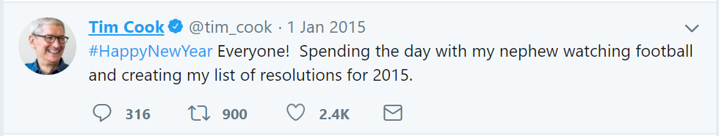
Unrelated Data

Slide 10
Step 3: Data filtering
Regular expression
Regular expression is essentially a tiny, highly specialized programming language which can specify the rules for the set of possible strings that you want to match.
(?<![\w\d])company(?![\w\d])
Which means that we want to match a string with ‘company’ , but we don’t want any alpha characters (\w) or decimal numbers (\d) precede or after it. So that we can get the text data with exactly “company” word inside it.
We don’t want to get a string with ‘accompany’ which also contain a ‘company’ pattern

Slide 11
Advantages
Simple to use , a. user accounts csv file b. specify the timeframe c. specify the keywords
Get all historical data
Free

Slide 12
Data Processing & Sentiment Analysis

Slide 13
Tasks Performed in this Data Processing
Task 1: Cleaning Data
Task 2: Visualization of Dataset
Task 3: Sentimental Analysis
Cleaning the unnecessary data like stopwords, unwanted URL’s etc.
BarPlot and Graph
Wordcloud

Slide 14
Task 1: Cleaning Data
Transformations
In order for R to interpret and analyze these text files they must ultimately be converted into a document term matrix.
Simplifying structure of sentence
The tm package provides a function tm_map() to apply cleaning functions to an entire corpus, making the cleaning steps easier.
tm_map() takes two arguments, a corpus and a cleaning function. Here, removeNumbers() is from the tm package.

Slide 15
What we Cleaned in Data..
Converting Text into Lowercase.
Removing Punctuation Marks.
Removing any Numerical value from the tweets.
Removing stop words.
Removing Unwanted URLs.
Removing Whitespaces.
Clearing repetition of same words.

Slide 16
Task 2: Visualization on the Dataset
1. Bar plot
The plot will have bars with their heights equal to the elements in the vector.
2. Wordcloud
Simplicity and Clarity
Engaging than table data

Slide 17
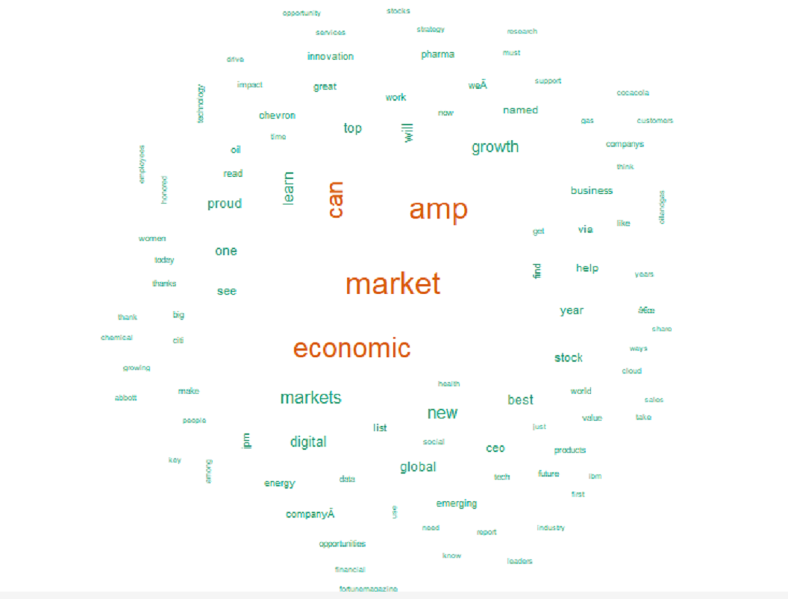
Wordcloud
function TermDocumentMatrix()
Picking out words whose occurrence is higher than 75.

Slide 18
Task 3: Sentimental Analysis
get_nrc_sentiment( ) function implements Saif Mohammad’s NRC Emotion lexicon.
the NRC emotion lexicon is a list of words and their associations with eight emotions (anger, fear, anticipation, trust, surprise, sadness, joy, and disgust).

Slide 19
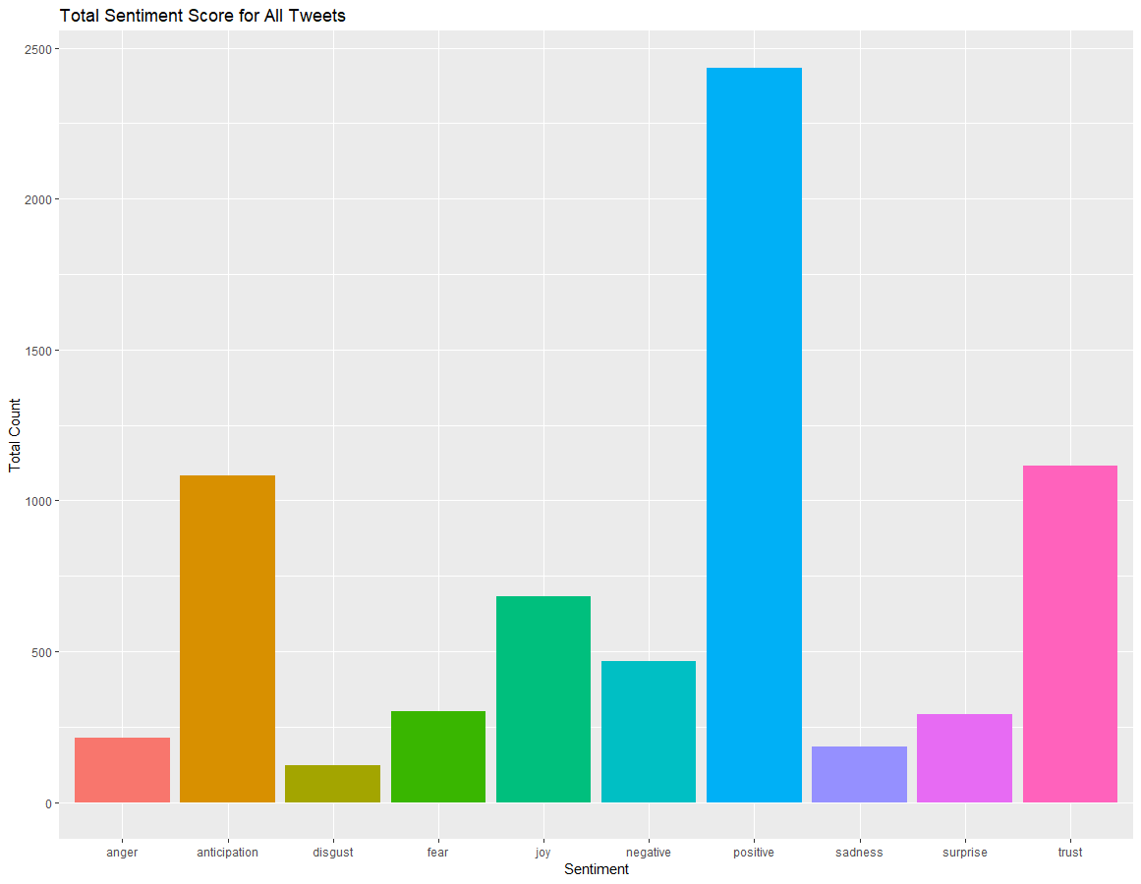
Sentimental Analysis
Bar Plot
Through above graph, the numbers of positive attitude much more than other attitude,trust and anticipation and attitude account for a large part in sentiment.

Slide 20
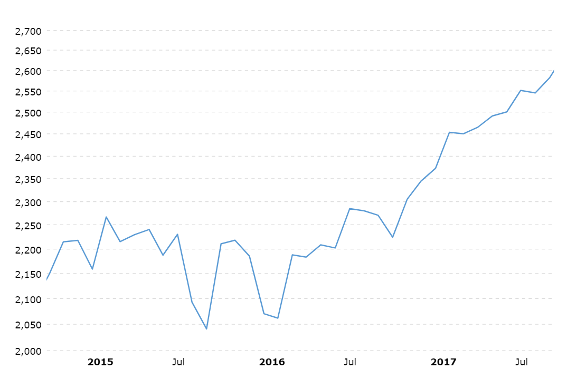
S&P 500
From 2015 to 2017,turning point happen on August,starting to tend to upward.after 2016 August S&P 500 keeping rising

Slide 21
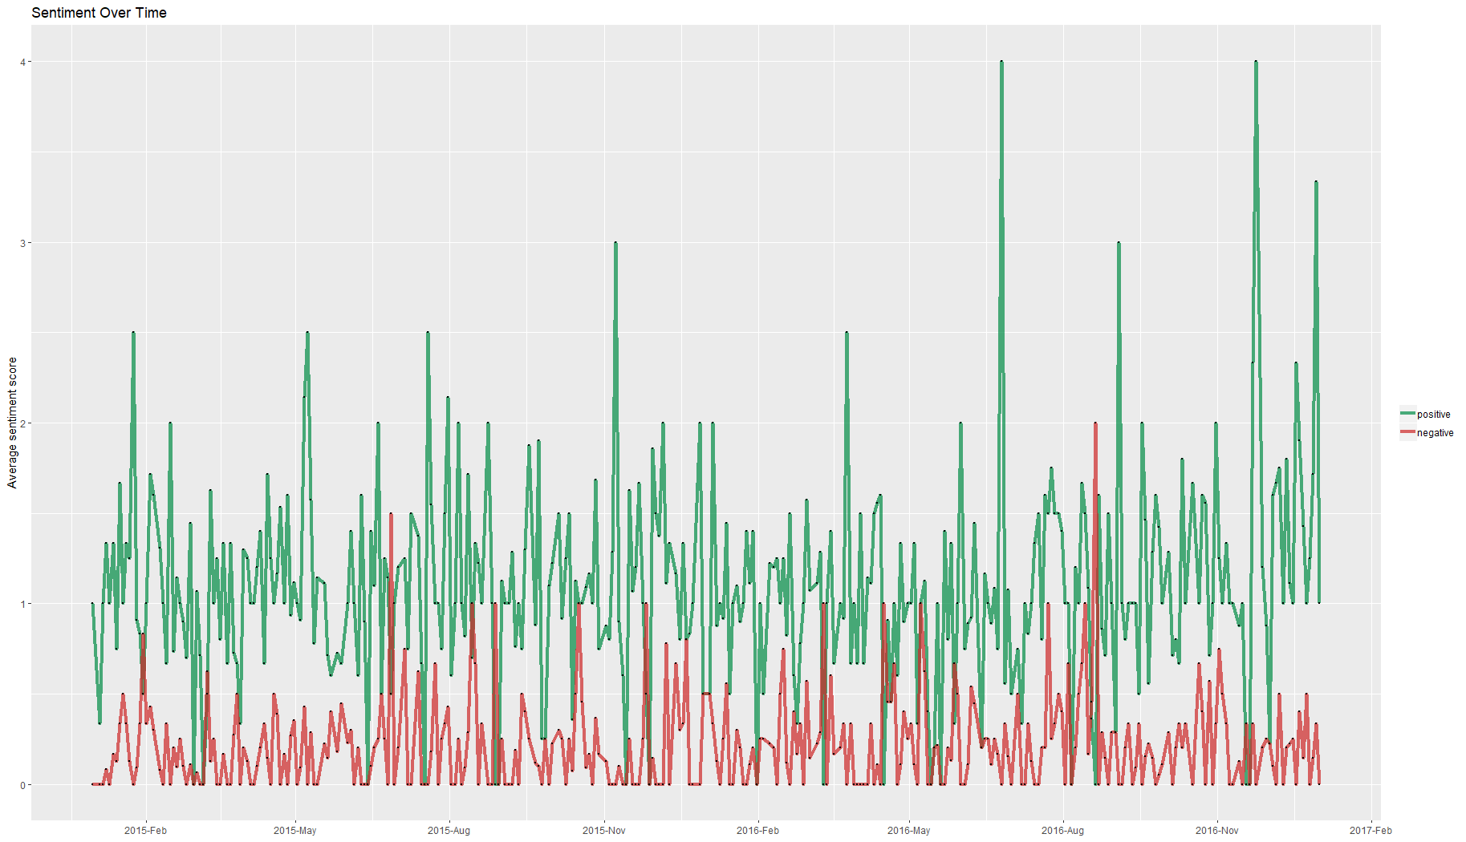
Sentimental Analysis
Over Time
X axis is time from 2015-Jan to 2017-Jan. The tendency of positive is stronger than negative

Slide 22
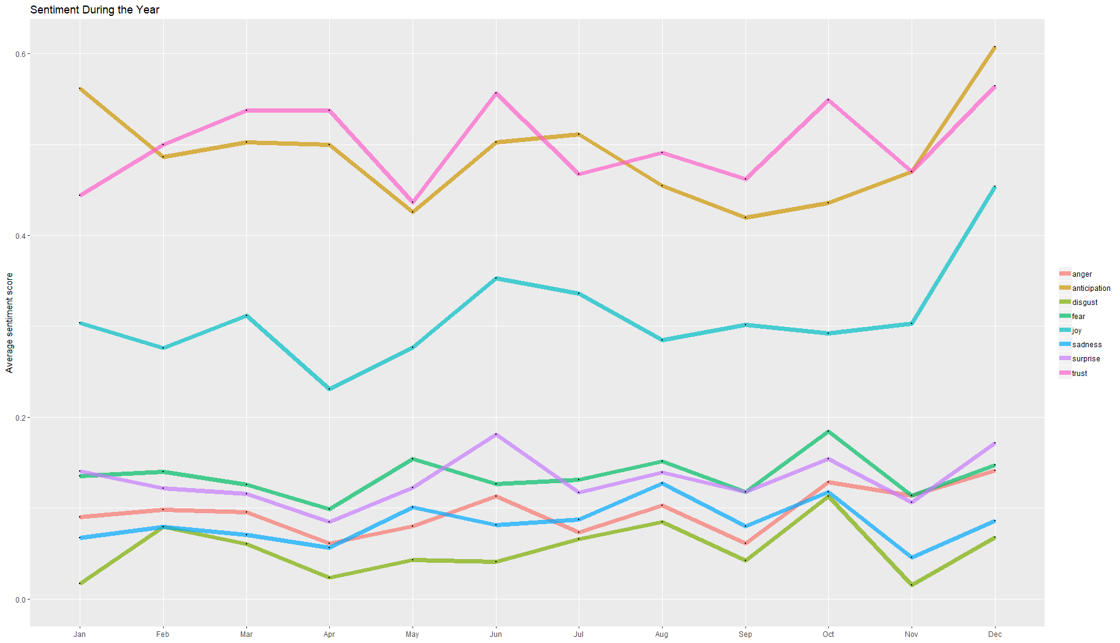
Sentimental Analysis During the Year
Through above graph, from August the attitude of joy and anticipation show upward trend.

Slide 23
Thank You
Questions?

